Slide 1
Isaiah
Lesson 3
When Your World is Falling Apart

Slide 2
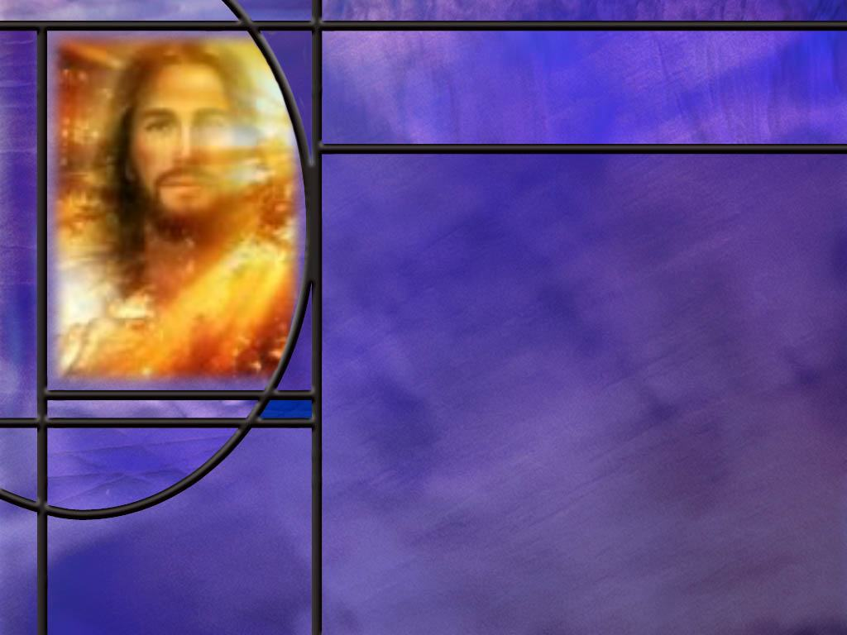
Memory Text
Isaiah 7:9 NKJV
… If you will not believe, Surely you shall not be established." ‘ “
What two options does the Lord offer Ahaz in this verse and what result does He promise?
How was Ahaz looking to “be established?”
What application can we make of these words, spoken by the Lord to Ahaz, to our own situations?
Notes:
B2:
1. You can either continue to not believe, or you can change and believe in the Lord.
2. If you don’t believe, you won’t be established.
3. If you do believe, the implication is that you will be established.
4. The language here implies that it is a mater of the will.
5. “If you will not believe” or if you refuse to believe, you’re going down.
6. But if you’re willing to believe on the Lord your God, then you can stand firm.
B3:
1. He was afraid of being over-run and defeated by an alliance of enemies to the north of Judah.
2. This was an alliance of Israel and Syria.
3. He was looking for a way to defeat their threats of invasion and subjugation and remain an independent nation.
B4:
1. There is always a temptation to trust human wisdom and the arm of the flesh to solve our problems.
2. We look around and try to find the best option for success in whatever the endeavor.
3. This is our natural inclination.
4. When we face a problem we immediately begin to look for different ways to solve it.
5. And that’s ok. I think that’s the way God created us.
6. We should be problem solvers; we should try to identify all of the options and weigh them carefully.
7. But we should always be aware of God’s offer in this promise.
8. I we want true success in life, we must be willing to believe.
9. If we refuse to believe and instead follow our own inclinations, we will, in the end, fail to be established.
10. Instead, we will be defeated and brought down to destruction.
11. Following our own path may lead to temporary victories, but in the end, we will suffer a bitter defeat without the Lord on our side.
12. When we follow God and His word, our life will have true success.
13. I think of Joshua’s words in the first chapter of his book:
Joshua 1:8 KJV This book of the law shall not depart out of thy mouth; but thou shalt meditate therein day and night, that thou mayest observe to do according to all that is written therein: for then thou shalt make thy way prosperous, and then thou shalt have good success.
14. Believing in the Lord and living by His word is the best way to succeed in this life and most certainly in the life to come.
15. How many want to choose to believe in the Lord Jesus Christ and let Him establish us forever in His kingdom?

Slide 3
Overview
In spite of the Lord’s offer to Ahaz to establish the nation of Judah under God’s protection, he foolishly chose to trust the arm of flesh rather than believe in the living God.
  King Ahaz and his Enemies
  God’s Intervention
  Second Chance
  Sign of a Son
  Summary

Slide 4
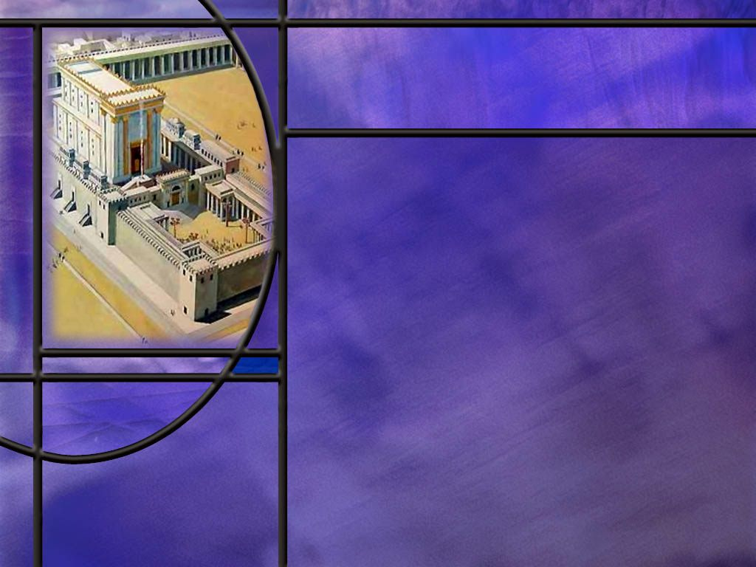
King Ahaz and His Enemies
What does the Bible reveal about King Ahaz and his reign in the nation of Judah? (2 Kings 16)
Notes:
B1:
[See notes on linked slides.]

Slide 5
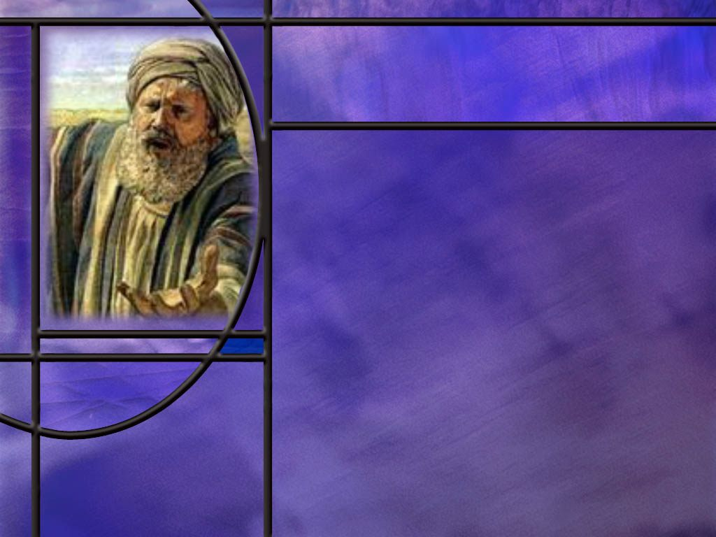
God Intervenes
How did God send Isaiah to King Ahaz and who did he take with him? (Isa 7:3)
What message did Isaiah give to Ahaz there at the aqueduct? (Isa 7:4-7)
What choice did God set before Ahaz that would give him the victory over his enemies? (Isa 7:9)
Notes:
B1:
[See notes on linked slide.]
B2:
[See notes on linked slide.]
B3:
[See notes on linked slide.]

Slide 6

Second Chance
What offer did the Lord make to Ahaz in order to strengthen his faith? (Isa 7:10-11)
What was the response of Ahaz? (Isa 7:12)
Notes:
B1:
[See notes on linked slide.]
B2:
[See notes on linked slide.]

Slide 7
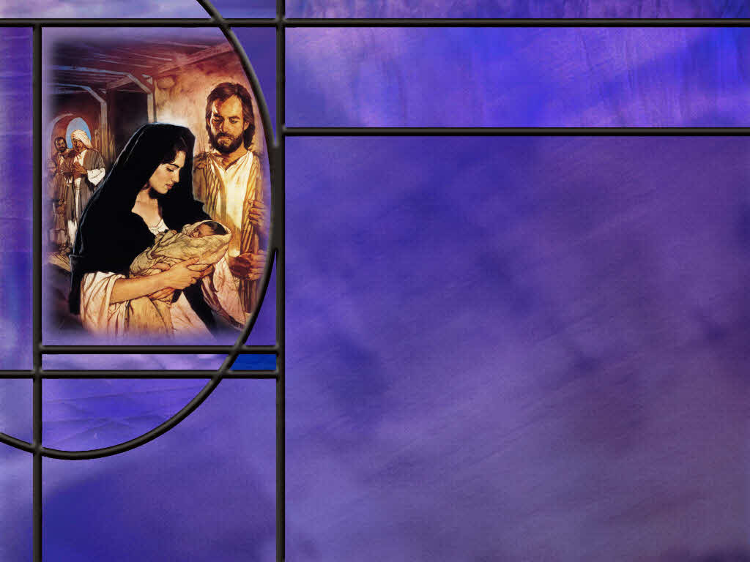
Sign of a Son
In spite of Ahaz’s rejection of God’s invitation to ask for a sign, what sign does God give? (Isa 7:13-14)
Some liberal interpreters claim that the proper translation should be “a young woman shall conceive” rather than “a virgin shall conceive,” and the “young woman” could refer to a married young woman.”
How would that be a sign from the Lord?
What promise do you find in the name Emmanuel?
Notes:
B1:
[See notes on linked slide.]
B2:
B3:
1. It wouldn’t be a “sign.” It would be a common everyday event.
2. This would take the “sign” out of the realm of the miraculous and place it in the realm of the ordinary.
3. The whole purpose of a sign is to strengthen our faith that God is on our side.
4. Matthew was very specific in noting that the virgin birth of Christ was a fulfillment of this prophecy.
Matthew 1:22-23 KJV Now all this was done, that it might be fulfilled which was spoken of the Lord by the prophet, saying, ²³ Behold, a virgin shall be with child, and shall bring forth a son, and they shall call his name Emmanuel, which being interpreted is, God with us.
B4:
1. It is a promise that God is always with those who trust in Him.
2. Since this title is applied specifically to Jesus, it means that Jesus is God.
3. This title reminds us of the many promises of Scripture that God cares for us and will always be with us.
4. This title was true when Jesus walked on this earth.
5. It is also true today as He has sent His HS to dwell in our hearts as His representative.
6. It was true in OT times as well when the preincarnate Christ desired to dwell with His people.
7. His last recorded words in Matthew’s gospel were, “And lo I am with you always, even to the end of the age.”
8. In Hebrews 13:5 He promises to never leave us nor forsake us.
9. Emmanuel is the promise that our Lord and Savior is with us now and will be through eternity.
10. He wants to be our Friend forever.
11. Hallelujah!

Slide 8
Summary
King Ahaz followed Uzziah and Jotham to the throne in Judah, but he did not follow their example of faithfulness to God. He was an evil king.
When threatened by Israel and Syria, King Ahaz of Judah made an alliance with the Assyrian empire, paying tribute to them and becoming a vassal king in their expanding empire.
Isaiah gives us the rest of the story of how God would have intervened on his behalf and establish him as an independent nation if only he would return to God in faith and believe.

Slide 9
Summary
When Isaiah and his son met Ahaz at the aqueduct, Isaiah conveyed God message to him that the invasion from the north by Israel and Syria would not succeed.
God challenged him to stand firm in faith, trusting the living God and His promises in order to be delivered.
God graciously gave him an opportunity to strengthen His faith by inviting him to ask for a sign of God’s power to deliver.
These opportunities to trust in divine power rather than in an alliance with the Assyrians were spurned by Ahaz.

Slide 10
Summary
His choice is a warning to us that a life of sin and rejection of the grace of God forms habits that enslave us to the world.
In spite of Ahaz’s rejection of a sign, God gave a sign to the house of David of a virgin who would conceive and bear a Son who would be called Emmanuel, God with us.
That prophecy was fulfilled in the Lord Jesus Christ who promised to be with us always, even to the end of the age.
When your world is falling apart, upon which arms do you choose to lean, the arms of flesh or the everlasting arms?

Slide 12
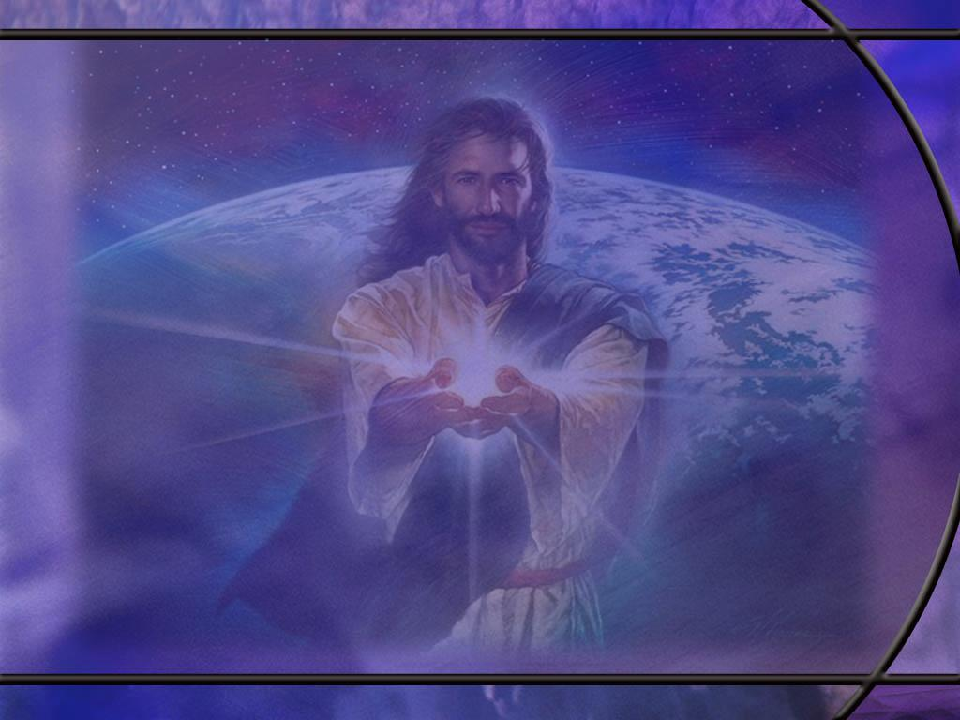
2 Kings 16:1-5, 7, 9 NKJV
In the seventeenth year of Pekah the son of Remaliah, Ahaz the son of Jotham, king of Judah, began to reign. ² Ahaz was twenty years old when he became king, and he reigned sixteen years in Jerusalem; and he did not do what was right in the sight of the LORD his God, as his father David had done. ³ But he walked in the way of the kings of Israel; indeed he made his son pass through the fire, according to the abominations of the nations whom the LORD had cast out from before the children of Israel. ⁴ And he sacrificed and burned incense on the high places, on the hills, and under every green tree.
Notes:
Q1: What do you think of this biographical sketch of King Ahaz?
1. Sad, but not surprising.
2. After a few good kings, the pendulum swings back to a wicked king.
3. This text says that he walked in the ways of the kings of Israel who were all evil kings that practiced idolatry and perverted the true worship of God.
4. This idea of making his son pass through the fire, is not just walking on hot coals.
5. It is human sacrifice.
6. The NIV says:
2 Kings 16:3 NIV - 3 He followed the ways of the kings of Israel and even sacrificed his son in the fire, engaging in the detestable practices of the nations the LORD had driven out before the Israelites.
7. Idolatry and human sacrifice. It can’t get much worse than that.
[Go to next slide.]

Slide 13
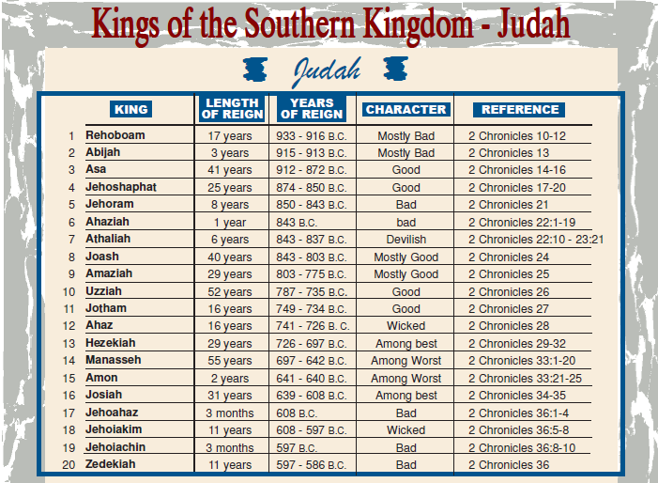
Notes:
1. This is a list of the kings of the southern kingdom of Judah beginning with Rehoboam.
2. Last time we talked about Uzziah at number 10, a good king.
3. His son Jotham was also good.
4. But then follows Ahaz who is the subject of our study today.
5. As we found in 2 Kings, he was a wicked king who reigned for 16 years.
6. He was an idol worshiper who sacrificed his children in the fire and perverted the worship at Jerusalem.
[Go to next slide]

Slide 14
2 Kings 16:1-5, 7, 9 NKJV
⁵Then Rezin king of Syria and Pekah the son of Remaliah, king of Israel, came up to Jerusalem to make war; and they besieged Ahaz but could not overcome him. ... ⁷ So Ahaz sent messengers to Tiglath-Pileser king of Assyria, saying, "I am your servant and your son. Come up and save me from the hand of the king of Syria and from the hand of the king of Israel, who rise up against me." ... ⁹ So the king of Assyria heeded him; for the king of Assyria went up against Damascus and took it, carried its people captive to Kir, and killed Rezin.
Notes:
Q1: How did King Ahaz handle this threatening situation?
1. Well he thought that he could buy peace by making an alliance with an enemy that was more powerful than the enemies that were threatening him.
2. And it looks like he bought peace for himself by paying tribute to a king and a kingdom that would allow him to rule as a vassal king under their protection.
3. But as we look at the book of Isaiah, we will find he could have made a much better deal with an even greater Protector.
[Go to next slide.]

Slide 15
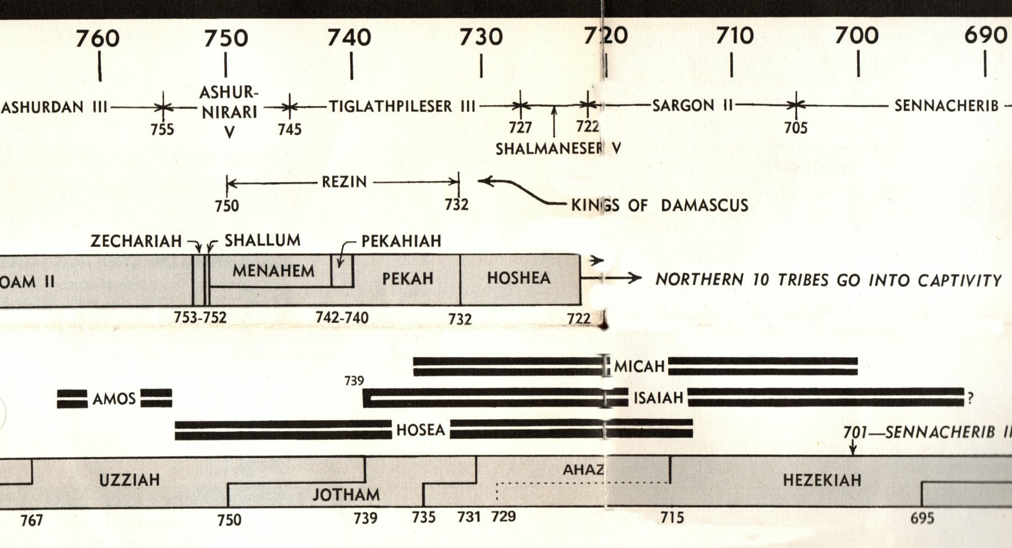
Timeline before Israel’s Captivity
Notes:
1. This shows the time line for the various prophets and kings before the Assyrian captivity in 722 BC.
2. The bottom row shows the kings of Judah: Uzziah, Jotham, and now Ahaz.
3. The dark double lines above show the prophets and the years of their prophetic ministry.
4. Note that Isaiah begins in the year King Uzziah died.
5. The next higher light gray row gives the kings of the northern tribes if Israel.
6. The current king of Israel is Pekah who ended his reign in 732 BC.
7. He was the next to last king before the ten northern tribes were carried off by the Assyrian empire in 722 BC.
8. In the next higher row is the king of Syria reigning from Damascus named Rezin.
9. Finally, the top row shows the reigns of the kings of the Assyrian empire.
10. At the time of our study, the king was Tiglath-Pileser III
11. The next slide shows a map of the region of these kings at the time of Isaiah.
[Go to next slide.]

Slide 16
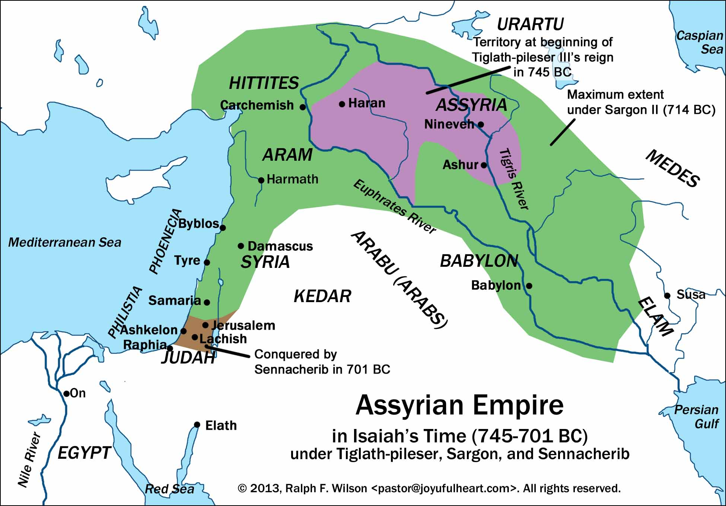
[R]
Notes:
1. The brown region shows the nation of Judah with its capitol of Jerusalem.
2. The northern tribes of Israel would be headquartered at Samaria under their king Pekah.
3. The Syrians would be headquartered in Damascus to the north led by king Rezin.
4. The Assyrian empire at this time was only the purple region headquartered in Nineveh.
5. The king there was Tiglath-Pileser III.
6. Assyria was expanding its empire from the purple area to the green area.
7. Israel and Syria had an alliance and they thought they could strengthen their forces by taking Jerusalem and Judah.
8. So they laid siege to Jerusalem but it didn’t fall.
9. Instead, Ahaz, the king of Judah, pays tribute to Tiglath-Pileser III of the Assyrian empire to protect him from the alliance of Israel and Syria.
10. Tiglath-Pileser III defeats the kings of Syria and Israel in 732 BC, ending the reigns of their kings and extending the Assyrian empire.
11.Ten years later in 722 BC, the northern tribes of Israel are deported to other parts of the kingdom and foreigners are imported to their land to intermarry with them.

Slide 17
Isaiah 7:3 NIV
Then the LORD said to Isaiah, "Go out, you and your son Shear-Jashub, to meet Ahaz at the end of the aqueduct of the Upper Pool, on the road to the Launderer's Field. [R]
Notes:
Q1: Why did God direct Isaiah to take his son with him?
1. His son had a very interesting name.
2. No doubt God directed Isaiah to give this name to him.
3. His name means “a remnant will return.”
4. “Hello, King Ahaz, meet my son, ‘a remnant will return’.”
5. So Isaiah is a prophet to the southern kingdom of Judah, warning them about their danger of losing the land.
6. Some one hundred years after Isaiah’s ministry ends, this prophetic name becomes a reality.
7. Judah is captured by Nebuchadnezzar and carried off into Babylonian captivity for 70 years after which a remnant would return.

Slide 18
Isaiah 7:4-7 NIV
Say to him, 'Be careful, keep calm and don't be afraid. Do not lose heart because of these two smoldering stubs of firewood--because of the fierce anger of Rezin and Aram and of the son of Remaliah. ⁵ Aram, Ephraim and Remaliah's son have plotted your ruin, saying, ⁶ "Let us invade Judah; let us tear it apart and divide it among ourselves, and make the son of Tabeel king over it." ⁷ Yet this is what the Sovereign LORD says: " 'It will not take place, it will not happen, [R]
Notes:
Q1: What was the Lord’s solution to Ahaz’s dilemma?
1. Be still and know that I am God.
2. Be careful, be calm, don’t be afraid, don’t lose heart.
3. You may think they’re going to torch Jerusalem, but I [God] see them as two smoldering stubs of firewood.
4. What they’re planning will not happen.
5. You can bank on it because the sovereign LORD has spoken it.
Q2: Would that have been sufficient for you?
1. End of problem.
2. I don’t need Tiglath-Pileser.
3. I don’t need to sell my soul to the devil.
4. I have the living God on my side and I will stand upon His word.
5. O how simple it seems to us looking back.

Slide 19
Isaiah 7:9 NIV
… If you do not stand firm in your faith, you will not stand at all.’ “ [R]
Notes:
Q1: What did Ahaz have to do to experience the deliverance of the Lord?
1. He had to stand firm in faith.
2. He had to believe and trust in the promise of God.
Q2: What do we have to do to experience the deliverance of the Lord?
1. The same thing: stand firm in the faith.
2. Jesus said:
Matthew 24:13 KJV But he that shall endure unto the end, the same shall be saved.
3. As the apostle Paul reached the end of his life, he could write:
2 Timothy 4:7 KJV - I have fought a good fight, I have finished my course, I have kept the faith:
4. It is by grace that we are saved, and we receive that grace by faith.
Acts 16:31 KJV - Believe on the Lord Jesus Christ, and thou shalt be saved.
Romans 10:9 KJV if thou shalt confess with thy mouth the Lord Jesus, and shalt believe in thine heart that God hath raised him from the dead, thou shalt be saved.
5. Final deliverance from sin and its wages comes only to those who stand firm in the faith.
6. And ultimately, that’s the only deliverance that matters.

Slide 20
Isaiah 7:10-11 NIV
Again the LORD spoke to Ahaz, ¹¹ "Ask the LORD your God for a sign, whether in the deepest depths or in the highest heights.“ [R]
Notes:
Q1: What does this tell you about God?
1. God is willing to provide evidence upon which we can base our faith.
2. Here He offers to give Ahaz a sign, any sign he can think of, to show that the Lord can keep His word to deliver him.
3. We all remember Gideon’s fleece.
4. Two times God honored the sign for which Gideon asked.
Q2: In general, do you think it is a good practice to ask God for signs?
1. In general, no.
2. Performing specific miracles to build our faith is not the way God usually works.
3. He has given us His word, the holy Scriptures.
4. His word proves itself to be true by the fulfilled prophecies it contains.
5. He has given us the complexity of nature in all we see around us and the specified complexity of living organisms.
6. The evidence for faith is sufficient for all those with a willing heart.
7. So while God has given us all the signs we need, if He were to invite us to ask for a sign like He invited Ahaz, no problem!

Slide 21
Isaiah 7:12 NKJV
But Ahaz said, "I will not ask, nor will I test the LORD!“ [R]
Notes:
Q1: What do you think of this response?
1. It rejects the invitation that the Lord has given to strengthen his faith.
2. This spurns the grace of God by rejecting the invitation of God to believe.
3. Here Ahaz makes his choice that he would rather trust the arm of flesh in a political alliance than to trust the everlasting arms of the sovereign God to deliver him.
Q2: Is there a lesson we can learn from Ahaz and his rejection of grace?
1. There is a danger in rejecting the convictions of God brought to us through the Holy Spirit.
2. Ahaz was a wicked king that had long ago turned his back on the true God.
3. He was participating in idolatry and worshipping who knows what.
4. When we have repeatedly rejected the convictions of the Holy Spirit we can arrive at the place where we no longer have the capacity to say yes to God.
5. God forbid that we should ever come to that point of rejecting the grace of God.
6. Let us resolve to be obedient to the convictions of the Spirit and obedient to the commandments of God.

Slide 22
Isaiah 7:13-14 NKJV
Then he said, "Hear now, O house of David! Is it a small thing for you to weary men, but will you weary my God also? ¹⁴"Therefore the Lord Himself will give you a sign: Behold, the virgin shall conceive and bear a Son, and shall call His name Immanuel. [R]
Notes:
Q1: To whom is this sign directed?
1. You can sense the exasperation in Isaiah’s voice.
2. It is not just Ahaz that has rejected the sign, but the whole house of David that has wearied God.
3. Therefore the sign is given to the house of David.
4. And it is through David’s line that the Messiah would come.
5. That is an indication that this is a Messianic prophecy.

